Slide 1


Slide 2

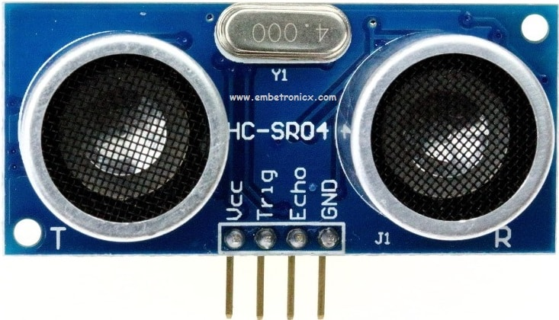

What is an ultrasonic sensor?
An electronic instrument that uses ultrasonic sound waves (through air) to measure the distance of the target object and the reflected sound is converted into electrical signal

Slide 3
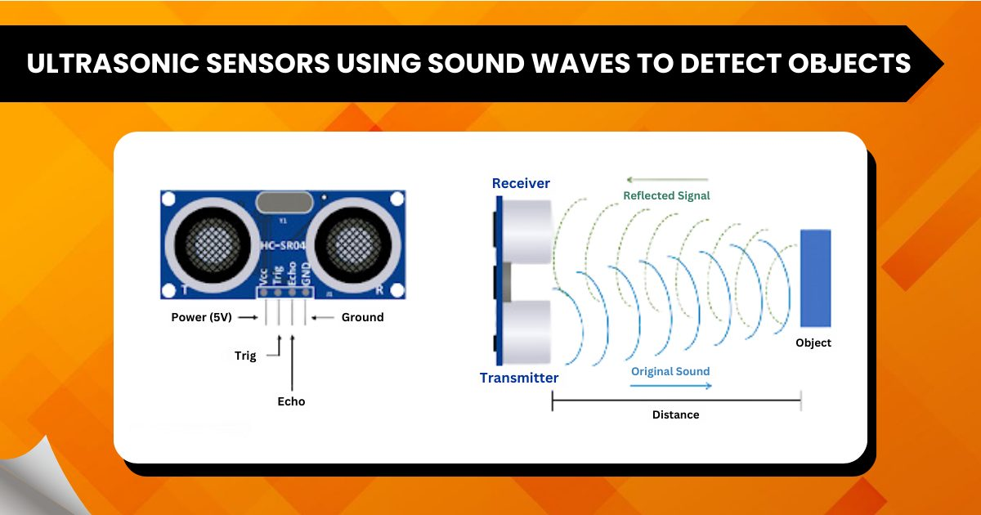
Ultrasonic sensors use high-frequency sound waves (ultrasonic waves) to measure distances or detect objects.
These sensors are commonly used in robotics.
Working:
1. Emitting ultrasonic waves
2. Detecting the echoes that bounce back from objects
3. Calculating the distance based on the time-of-flight (time it takes for the echo to return)

Slide 5
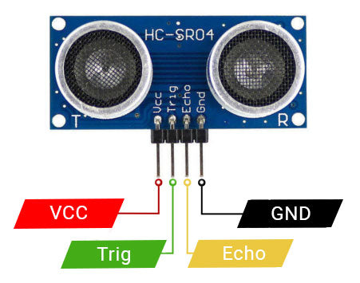
Hear ultrasonic waves: The frequencies are too high for human ears to detect.
Ultrasonic waves typically operate at frequencies above 20 kHz, which is beyond the human audible range (20 Hz to 20 kHz).

Slide 6
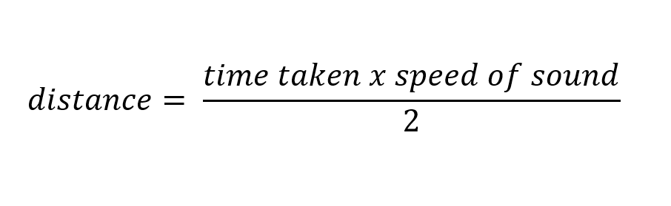
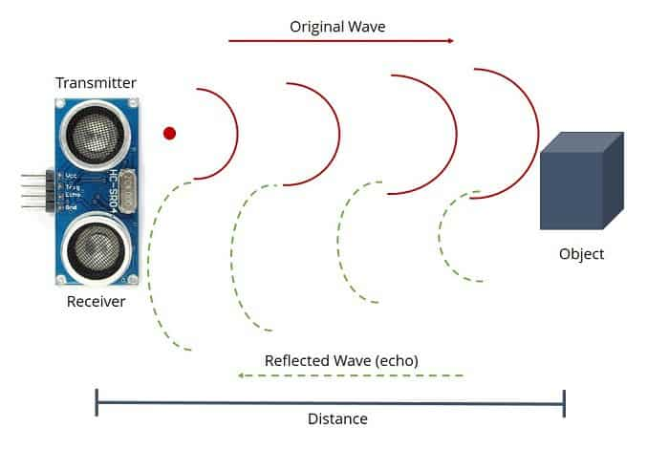

Slide 7
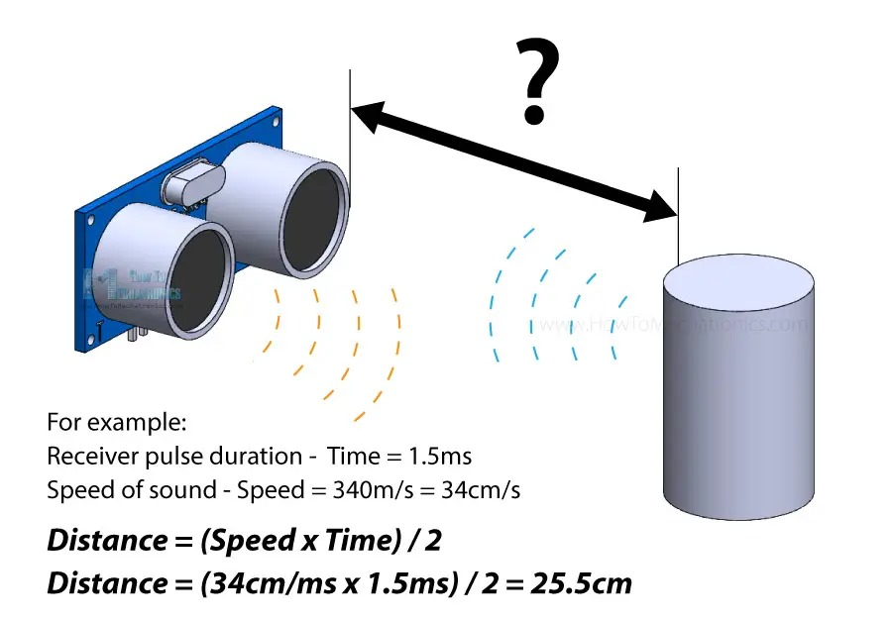
The formula to calculate distance using ultrasonic
Distance = Speed of Sound × Time / 2
1. Distance is the calculated distance to the object
2. Speed of Sound is approximately 343 meters per second (m/s) in air at room temperature
3. Time is the time-of-flight (TOF) - the time it takes for the ultrasonic wave to travel to the object and backThe division by 2 accounts for the round trip (to the object and back).This formula allows ultrasonic sensors to accurately measure distances!

Slide 8
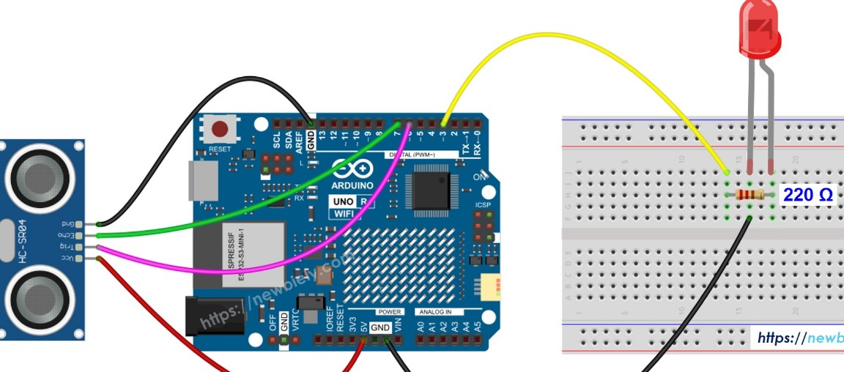
ultrasonic sensor converts reflected sound waves into an electrical signal that an Arduino microcontroller can interpret to measure distance.
The sensor works by sending out an ultrasonic sound pulse, then measuring the time it takes for the echo to return after bouncing off an object.
This time-of-flight is used by the Arduino microcontroller to calculate the distance to the object.

Slide 9
THANK YOU

Slide 10


